Slide 1


E-Commerce: What Matters Most ?
Presented by: Sean Lane and Casey Hill

Slide 2
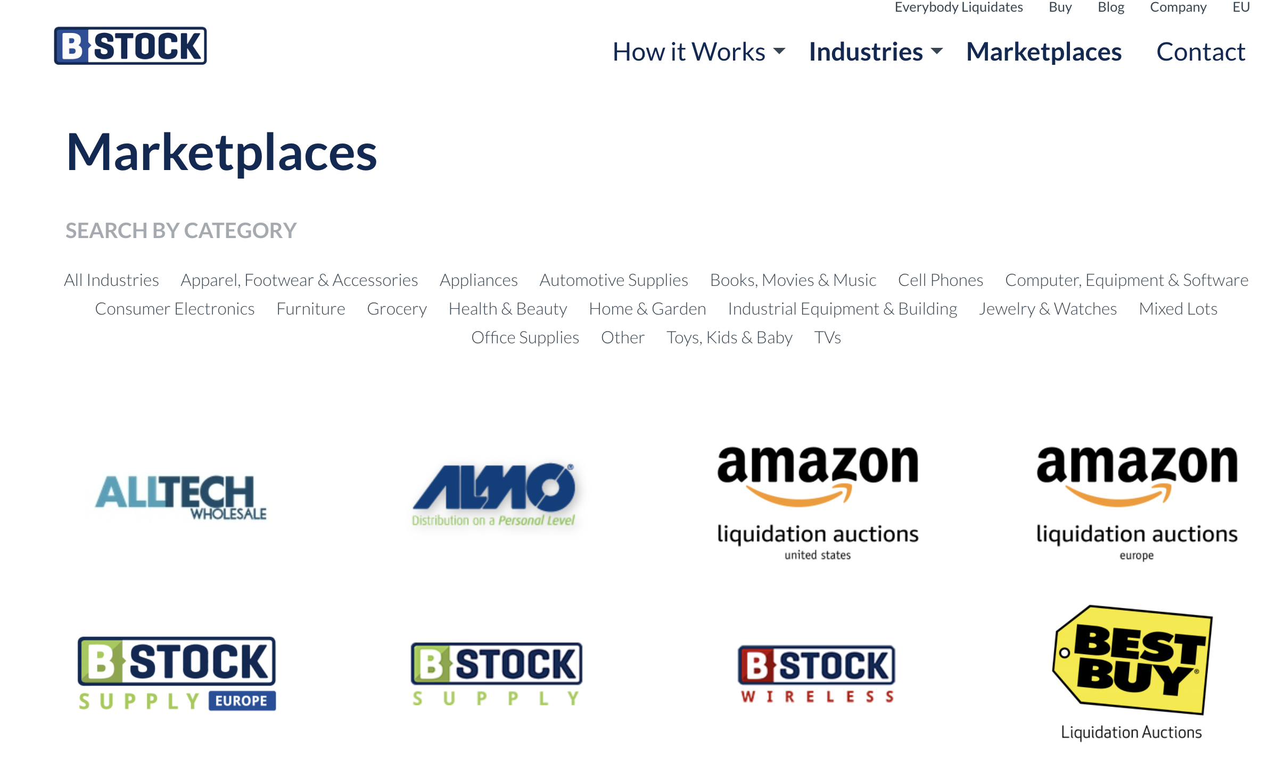
How B-Stock Works

Slide 3
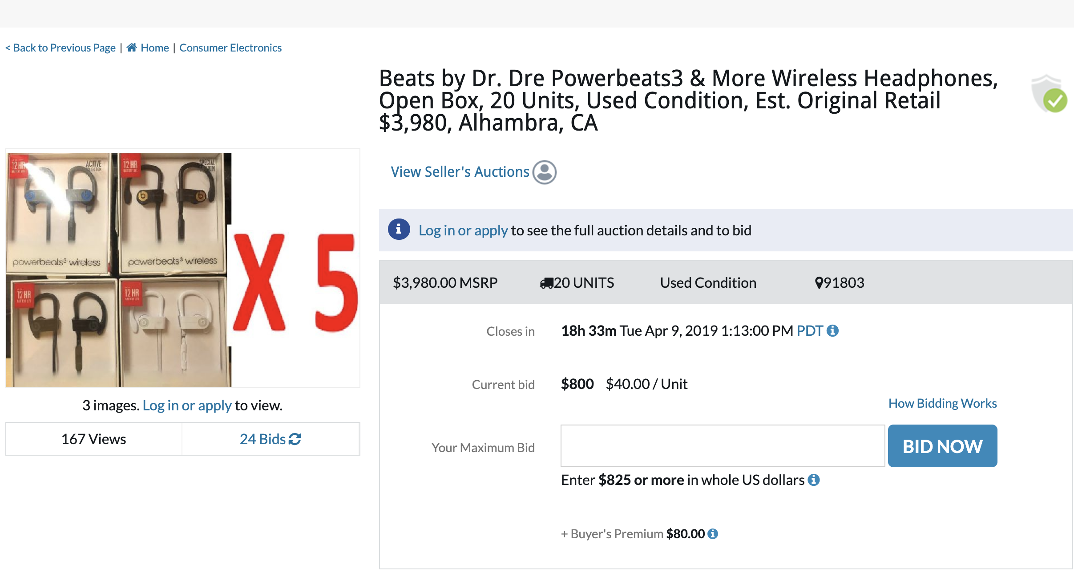
How B-Stock Works

Slide 4
What Matters Most ? (New vs. Legacy)
Current e-commerce sites can sometimes focus on the wrong data, giving their leadership and company a sense that REGISTERED USERS will be the driving force of marketplace health. Our hypothesis is that User Recency is the true driving force of a marketplace business - Essentially, your total user count doesn’t matter, it’s your frequent users that will be the “north star” from which your business can rely on growth.

Slide 5


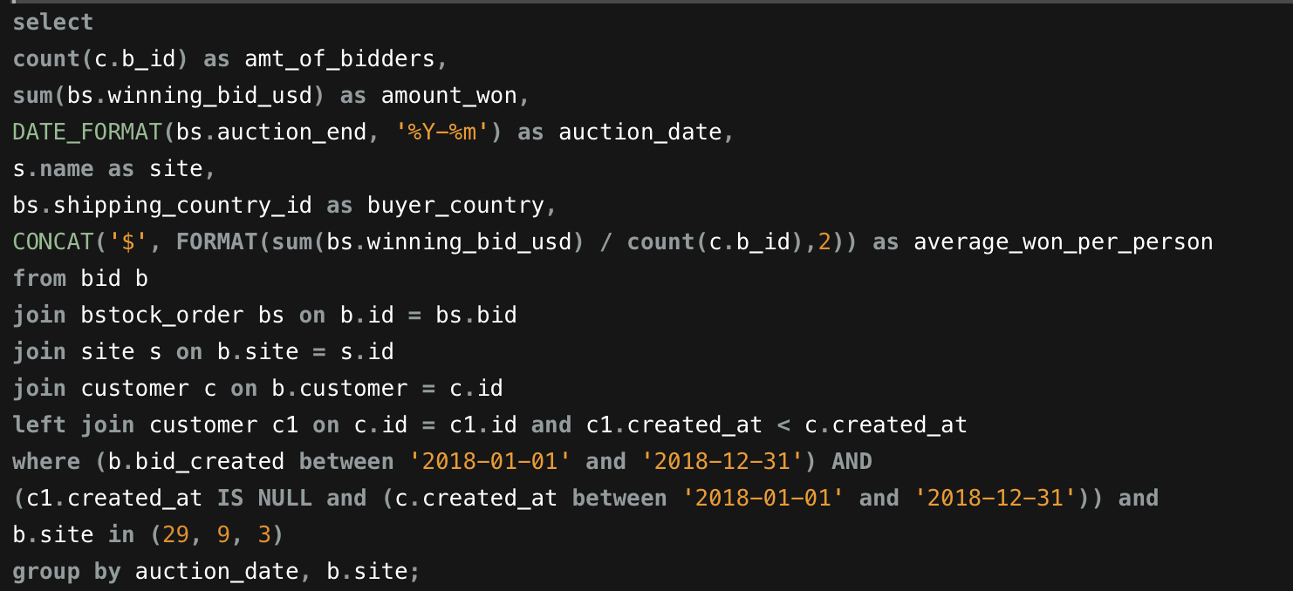
ETL
Using B-Stock’s existing MySQL Database, we extracted monthly data on the amount of approved users, bids created, and auctions won for our marketplaces.
The data is in monthly steps during 2018..
Aggregate data for all brand new users

Slide 6
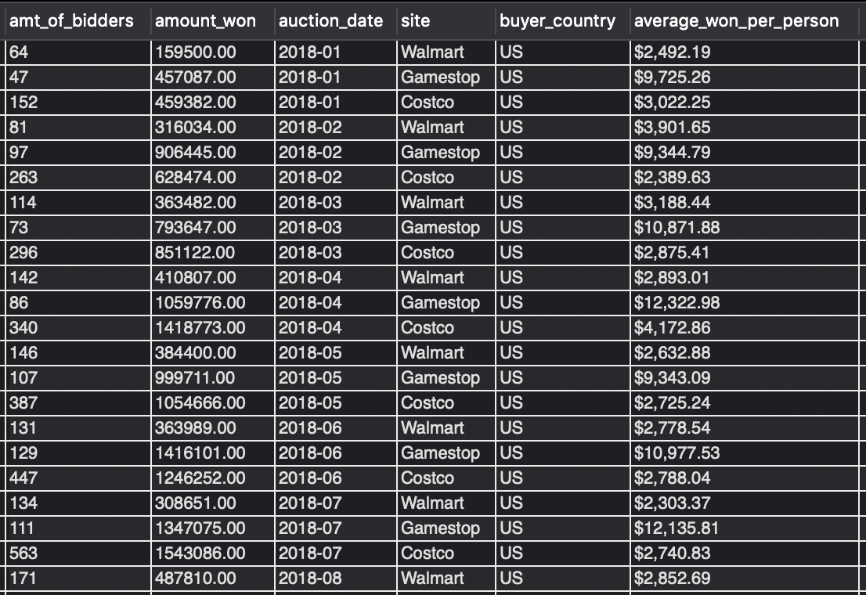
ETL
Once extracted for aggregate , we used the same code to pull data for the individual bidders of the sites
We also pulled total data numbers for our sites to compare to the timeframe..
Data was then saved into csv files for loading into our visualizations.

Slide 7
The Marketplaces
Costco:
Marketplace Contents: Mixed Lots, Apparel and Electronics
Other Stats: 2nd largest Marketplace on B-Stock
Sales are private- You can’t view auctions unless an approved buyer
Walmart:
Marketplace Contents: Mixed Lots, Apparel
Other Stats: Only the Walmart.com Returns processed through B-Stock
Gamestop:
Marketplace Contents: Electronics, Mobile Devices
Other Stats: Mobile phones account for a majority of B-Stock Sales
Notes:
Walmart: 4% of all walmart returns

Slide 8
Conclusion
New Buyers: Larger Revenue per person
Old Buyers: Disproportionately higher total revenue
Newer Buyers Bring More Buying Power - MORE MONEY!
Nurture your new buyers to continue to buy at their current levels or upgrade - You have a great opportunity to upgrade your “old” buyer cohort with these new high revenue customers

Slide 9
Questions?

